Slide 1


Tutorial to setup on local machine
Local LLM Deployment and Interaction
By - Kaushikee Bhawsar

Slide 2
Section 1: Setting Up Ollama
Download & Installation
Interacting with llama3 using curl command
Section 2: Setting Up GPT4ALL
Download & Installation
Interacting with orca-mini-3b using curl command
Content

Slide 3

Setting up Ollama
Ollama is a language model platform that offers customizable and efficient generative AI models for various applications.
Key Features of Ollama -
On-Device Execution
Fine-Tuning Capabilities
Efficient Performance
Easy Integration
Notes:
Ollama is a language model platform that offers customizable and efficient generative AI models for various applications.
Customizable Models:
On-Device Execution: Models can run directly on users' devices for better performance and privacy.
Fine-Tuning Capabilities: Users can fine-tune models to better suit their specific needs and applications.
Efficient Performance:
Optimized for Devices: The platform is optimized to leverage the processing power of local devices, making it faster and more responsive.
Integration:
Developer-Friendly: Ollama provides APIs and tools for easy integration into existing systems and workflows.

Slide 4
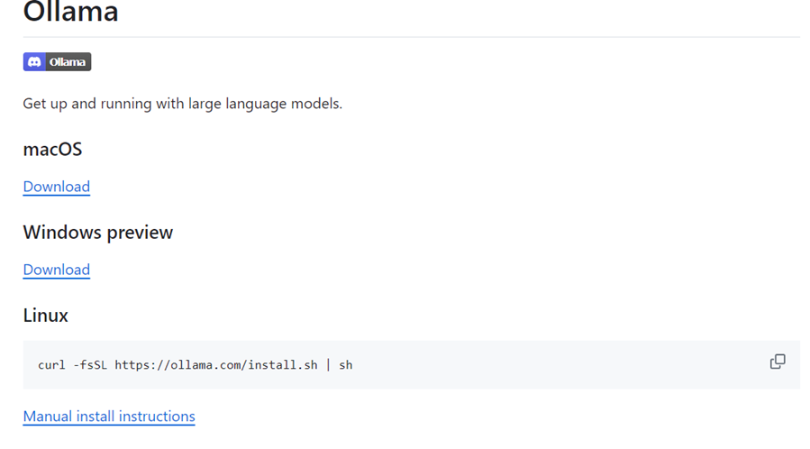
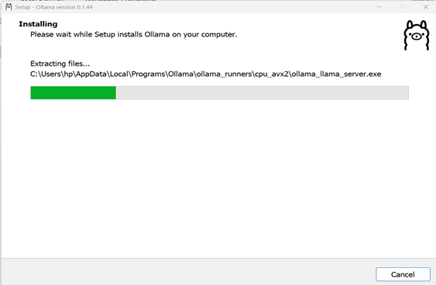
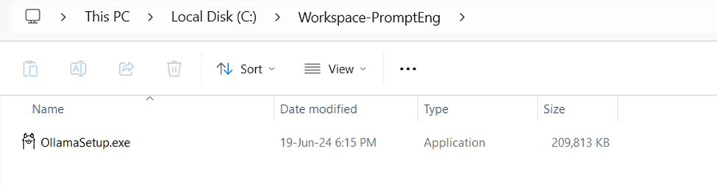
Ollama - Download & Installation
Step 1 | Visit the Ollama Github Page: https://github.com/Ollama/llama3
Step 1 | Download Ollama: Choose the appropriate version for macOS, Windows, or Linux.
Step 2 | Run the Installer: Execute OllamaSetup.exe and follow the prompts to complete the installation.
Step 2 | Installation Directory: Ollama will be installed in C:\Users\Programs

Slide 5
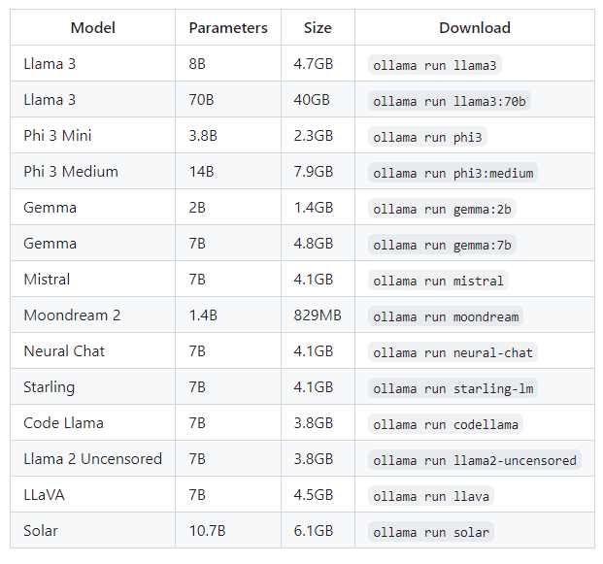
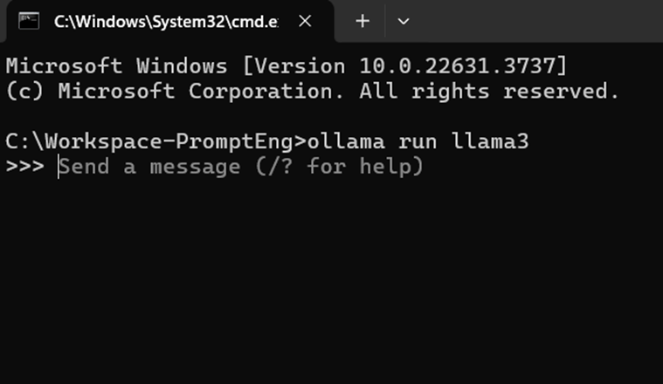
Step 1: Open Command Prompt: Navigate to your command prompt and Run Command: ollama run llama3
It will download llama3
And then prompt >>>Send a message
Running Ollama locally
Notes:
Ollama offers wide range of models,
Here are some example models that can be downloaded:
So for this tutorial we will be running llama3 8B which has size of 4.7GB

Slide 6
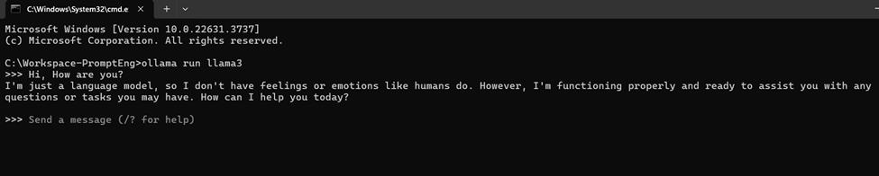
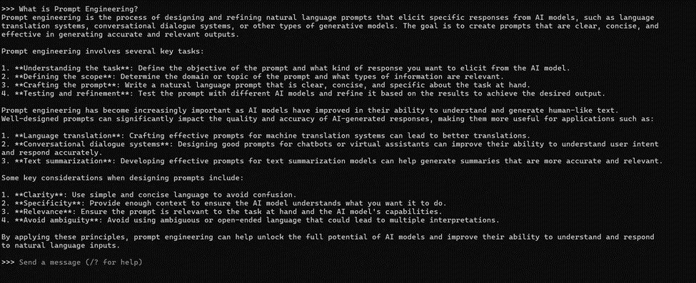
Start Interaction with llama3

Slide 7
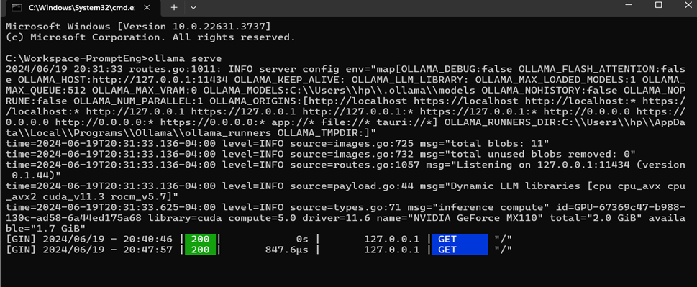
Interaction using curl command through Ollama server
Step 1. Open a command prompt and Run: ollama serve

Slide 8
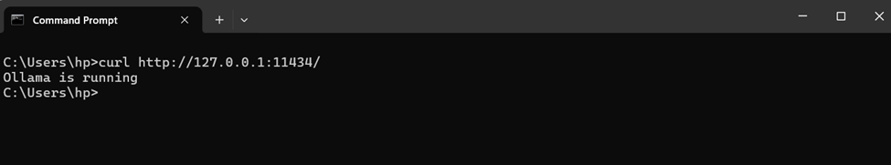
Interaction using curl command through Ollama server
Step 2. Check if ollama is running or not, open command prompt and run:
curl http://127.0.0.1:11434/

Slide 9
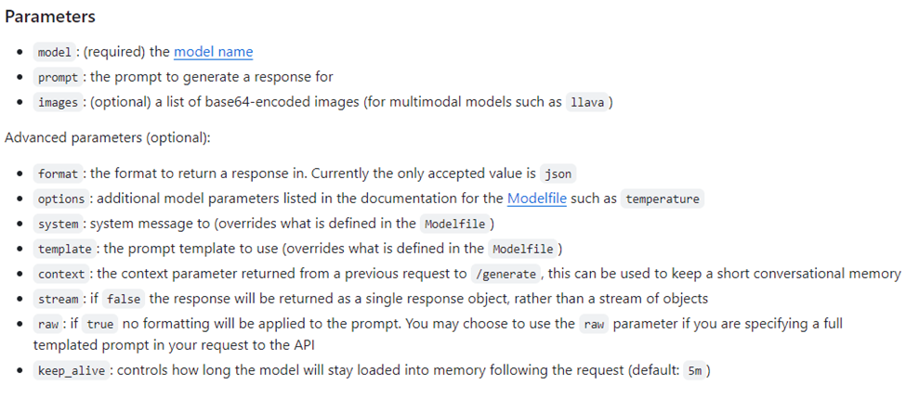
Interaction using curl command through Ollama server
GENERATE a completion -- using POST/api/generate
Before that, lets familiarise with parameters
Notes:
Using this api endpoint - it will Generate a response for a given prompt with a provided model. This is a streaming endpoint, so there will be a series of responses. The final response object will include statistics and additional data from the request using the parameters shown in the picture.

Slide 10
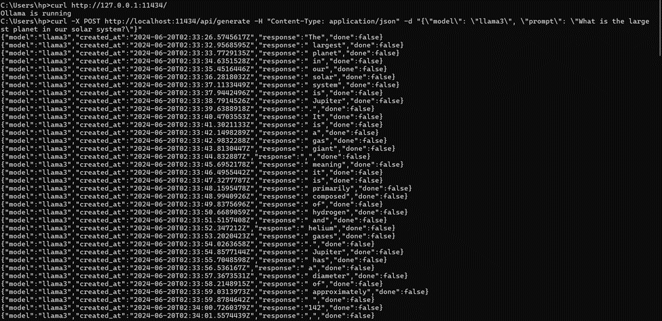
a. Generate request (Streaming)
Request:
curl -X POST http://127.0.0.1:11434/api/generate -H "Content-Type: application/json" -d "{\"model\": \"llama3\", \"prompt\": \"Why is the sky blue?\"}"
Response:

Slide 11
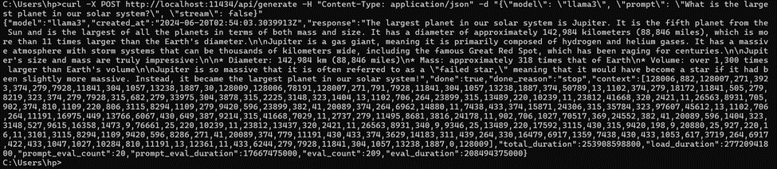
a. Generate request (No Streaming)
Request:
curl -X POST http://localhost:11434/api/generate -H "Content-Type: application/json" -d "{\"model\": \"llama3\", \"prompt\": \"What is the largest planet in our solar system?\", \"stream\": false}"
Response:

Slide 12
Interaction using curl command through Ollama server
2. GENERATE a CHAT completion -- using POST/api/chat
Request:
curl -X POST http://localhost:11434/api/chat -H "Content-Type: application/json" -d "{\"model\": \"llama3\", \"messages\": [{\"role\": \"user\", \"content\": \"Hello!\"}], \"stream\": false}"
Response:
3. List local modals-- using GET/api/tags
Request:
curl http://localhost:11434/api/tags
Response:
Notes:
Generate the next message in a chat with a provided model. This is a streaming endpoint, so there will be a series of responses. Streaming can be disabled using "stream": false. The final response object will include statistics and additional data from the request.
List models that are available locally.

Slide 13
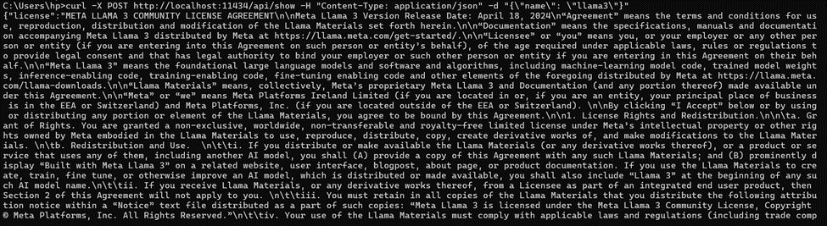
Interaction using curl command through Ollama server
4. Show model information --using POST/api/show
Request:
curl -X POST http://localhost:11434/api/show -H "Content-Type: application/json" -d "{\"name\": \"llama3\"}"
Response:
Notes:
it will Show information about a model including details, modelfile, template, parameters, license, system prompt.

Slide 14

Setting up GPT4ALL
GPT4All is an open-source project that provides accessible, versatile, and privacy-friendly large language models (LLMs) for various applications. It aims to democratize the use of LLMs by offering models that can be run on local devices without requiring extensive cloud infrastructure.

Slide 15
GPT4ALL - Download & Installation
Download the GPT4All Chat Client or GPT4All Python Client based on preference | Download the GPT4All Chat Client or GPT4All Python Client based on preference
GPT4All Chat Client | Provides a GUI-based interface
GPT4All Python Client | Allows you to interact via Python scripts and run a local server.
Notes:
GPT4ALL provides 2 ways to interact with it
1. Chat client
2. Python client

Slide 16
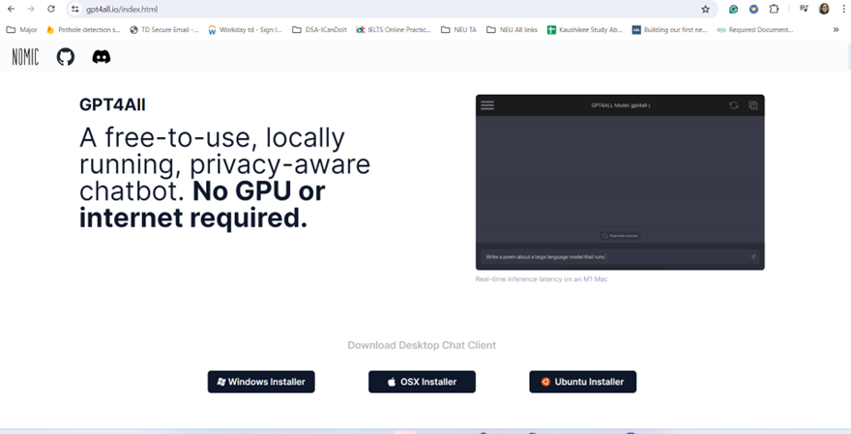
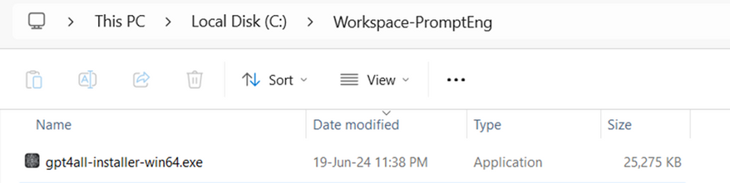
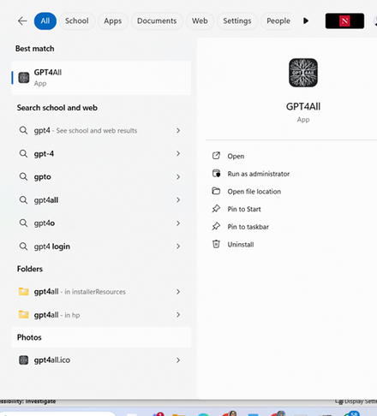
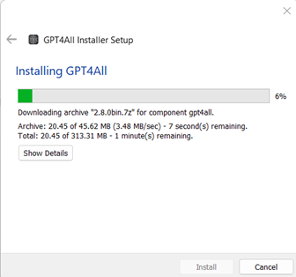
GPT4ALL - Download & Installation
To Install GPT4ALL Chat Client:
Step 1: Download and install GPT4ALL from https://gpt4all.io/index.html
Step 2: Run .exe file
Step 3: Follow the prompts to complete the installation
Step 4: Now, after successful installation, search GPT4All and open

Slide 17
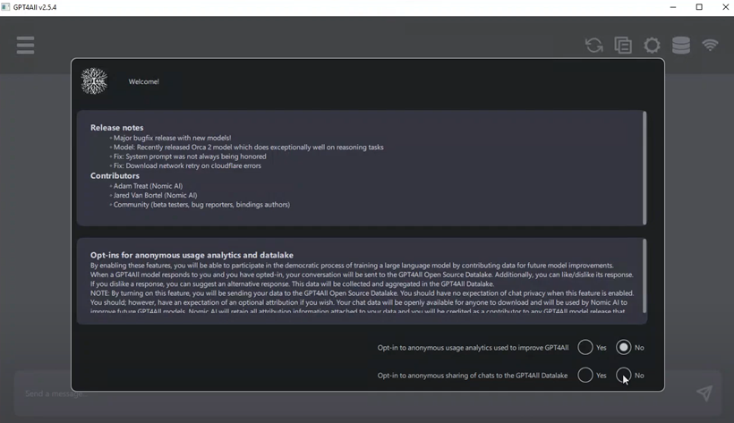
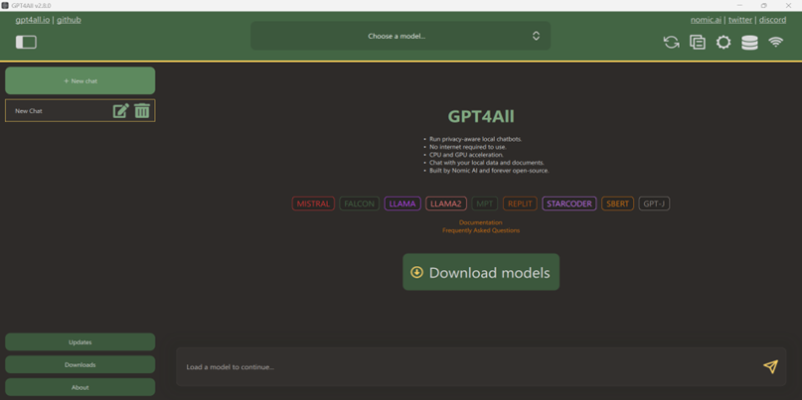
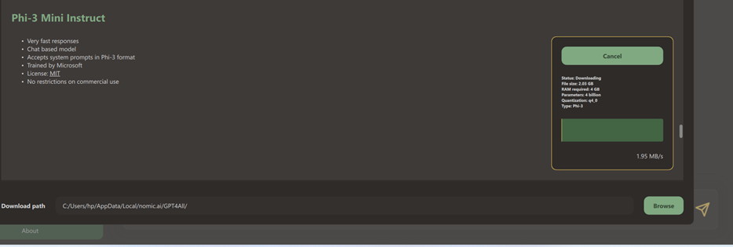
Interaction using GPT4ALL Chat Client:
Step 5: Select No in both
Step 6: Download model of your choice (see compatibility with the device)
Step 7: I installed Phi3 Mini

Slide 18
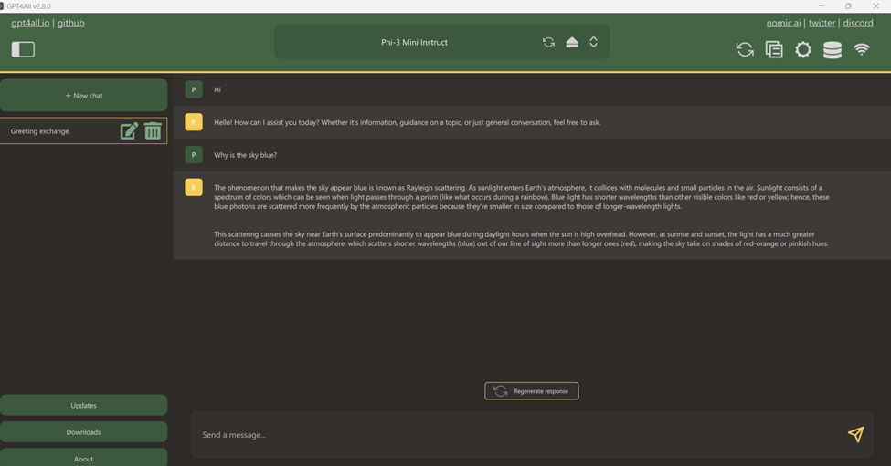
Interaction with Model Phi3 Mini using Chat Client

Slide 19
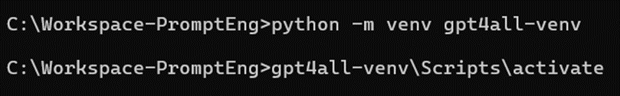
Interaction using curl command through Python Client
Install GPT4ALL Python Client–
Step 1. Create a virtual environment using command –
python -m venv gpt4all-venv
Step 2. Activate virtual environment –
gpt4all-venv\Scripts\activate
Step 3. (after activating, you will see (gpt4all-venv) before the project directory) like this -

Slide 20
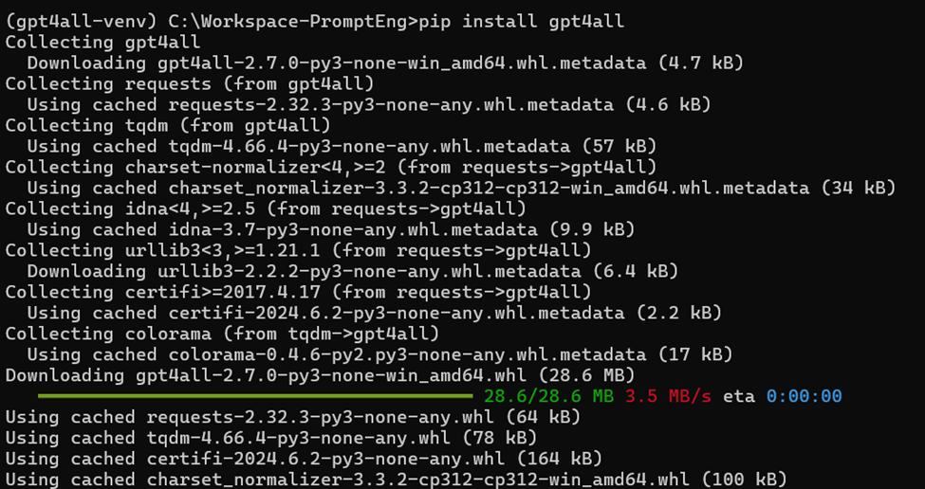
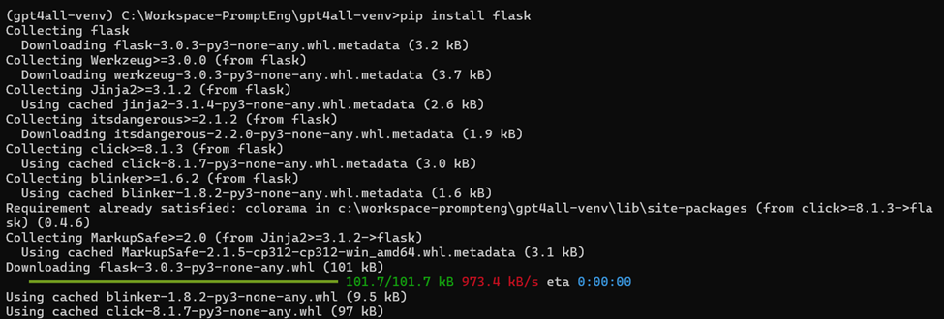
Interaction using curl command through Python Client
Install GPT4ALL Python Client–
Step 4: Then install GPT4ALL –
(gpt4all-venv) C:\Workspace-PromptEng>
pip install gpt4all
Step 5: Then install flask –
(gpt4all-venv) C:\Workspace-PromptEng>
pip install flask

Slide 21
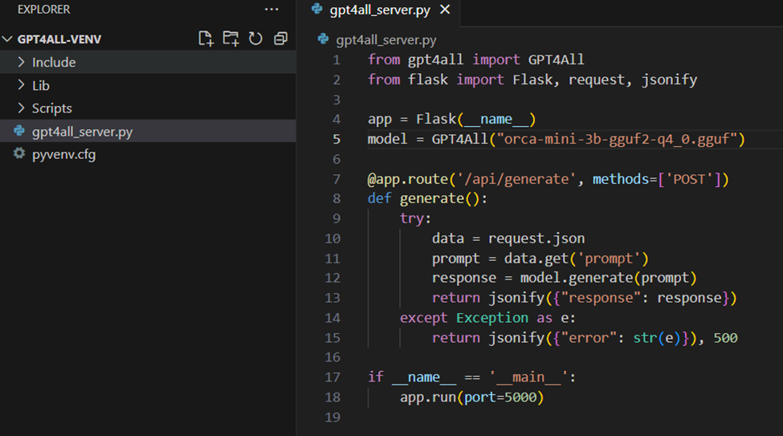
Interaction using curl command through Python Client
Step 6: Now, create a simple python script “gpt4all_server.py” as shown below in GPT4ALL-VENV folder and use the below GPT4ALL model
model = GPT4ALL("orca-mini-3b-gguf2-q4_0.gguf")

Slide 22
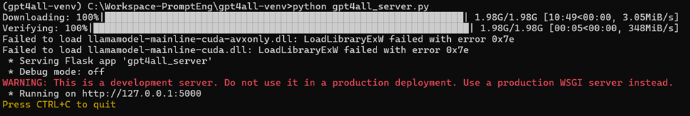
Interaction using curl command through Python Client
Step 7: Run the python script gpt4all_server.py using below command
(gpt4all-venv) C:\Workspace-PromptEng\gpt4all-venv>python gpt4all_server.py
And then our server will be running on http://127.0.0.1:5000

Slide 23
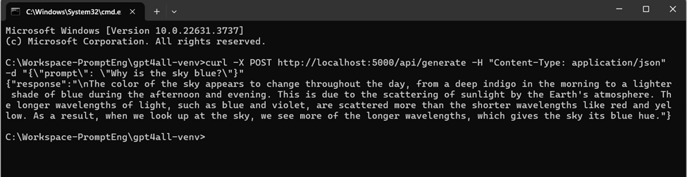
Interaction using curl command through Python Client
Step 8: Now open new command prompt to interact with curl command
Request: curl -X POST http://localhost:5000/api/generate -H "Content-Type: application/json" -d "{\"prompt\": \"Why is the sky blue?\"}"
Response:

Slide 24
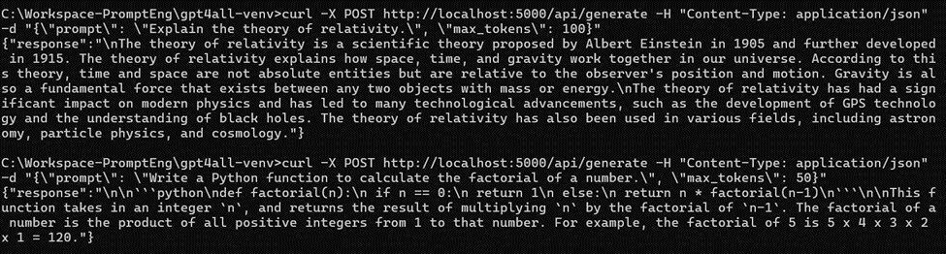
Interaction using curl command through Python Client
Request: curl -X POST http://localhost:5000/api/generate -H "Content-Type: application/json" -d "{\"prompt\": \"Write a Python function to calculate the factorial of a number.\", \"max_tokens\": 50}"
Response:

Slide 25

References
https://github.com/ollama/ollama/blob/main/README.md
https://github.com/ollama/ollama/blob/main/docs/api.md#request-json-mode
https://medium.com/thedeephub/50-open-source-options-for-running-llms-locally-db1ec6f5a54f

Slide 26

Thank you!

